Slide 1
Insurance Charges Estimation Project
HinYat Tsang

Slide 2
Introduction
This project involves building a predictive model for estimating insurance charges.
Three models were used:
1. Linear Regression
2. Ridge Regression
3. Lasso Regression
Cross-validation was used to fine-tune the alpha parameter in Ridge and Lasso.

Slide 3
Data Preprocessing
The dataset was preprocessed as follows:
1. One-hot encoding for categorical variables (sex, smoker, region).
2. Splitting into training and testing sets (80/20).
3. Linear, Ridge, and Lasso regression were applied.

Slide 4
Model Performance
Linear Regression:
MAE: $4181.19
MSE: 33,596,915.85
R²: 0.784
Ridge Regression (Best Alpha = 1):
MAE: $4193.59
MSE: 33,645,037.09
R²: 0.7833
Lasso Regression (Best Alpha = 100):
MAE: $4268.40
MSE: 34,245,278.35
R²: 0.7794

Slide 5
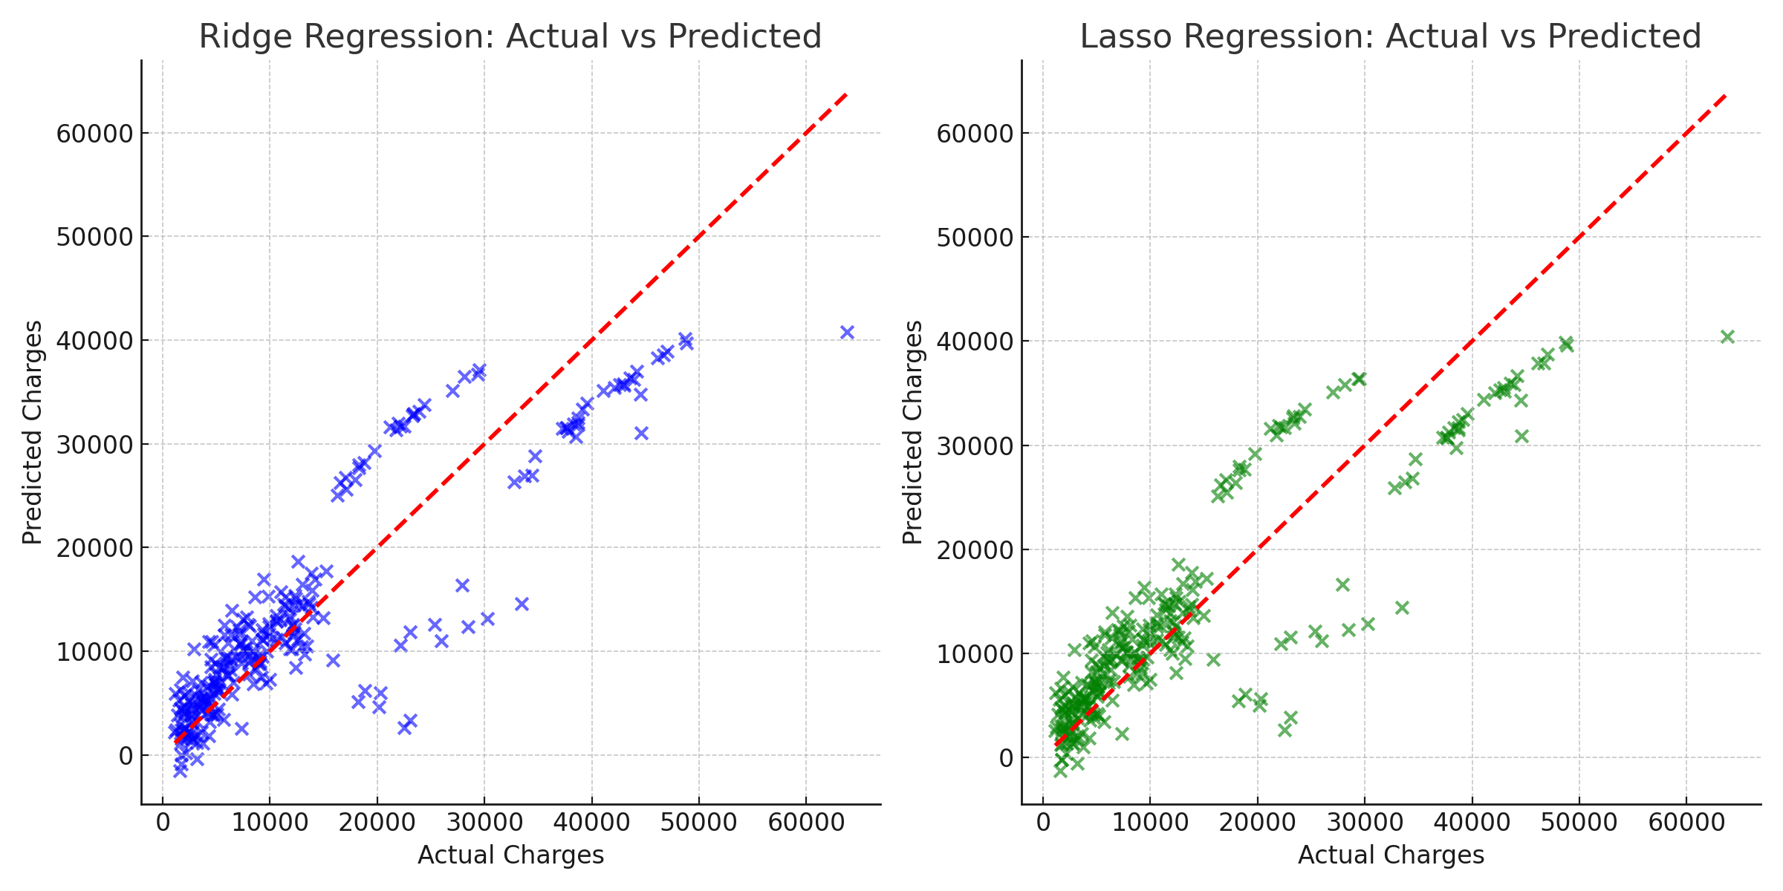
Actual vs Predicted: Ridge and Lasso Regression

Slide 6

Summary
In this project, we developed predictive models to estimate insurance charges using Linear, Ridge, and Lasso regression.
Key Takeaways: 1. Linear regression provided a strong baseline model. 2. Ridge regression with cross-validated alpha performed slightly better with less overfitting. 3. Lasso regression showed potential for feature selection but did not outperform Ridge in this case.

